Slide 1

Art for the heart

Slide 2



HELLO!
We are team Embers!
Aminat
David
Esther
Mnena
Pascal
Seun and
Summer.

Slide 3

1. OUR BUSINESS PLAN /MODEL
We have named our startup, “Artycool”

Slide 4

Artycool is an online art merchandise sales platform which aims to connect talented artists to interested buyers and vice versa.

Slide 5
Our Key activities
Art Merchandising
Art promotion
Talent discovery and promotion

Slide 6
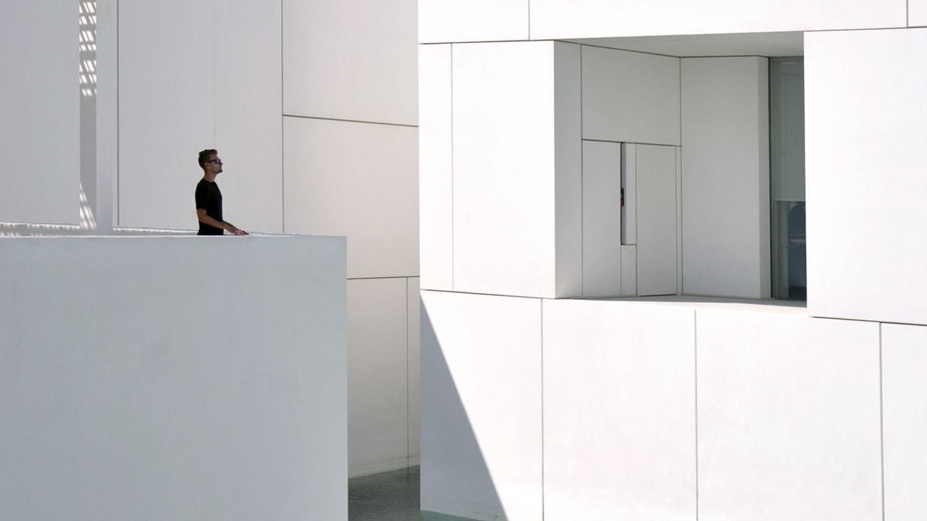
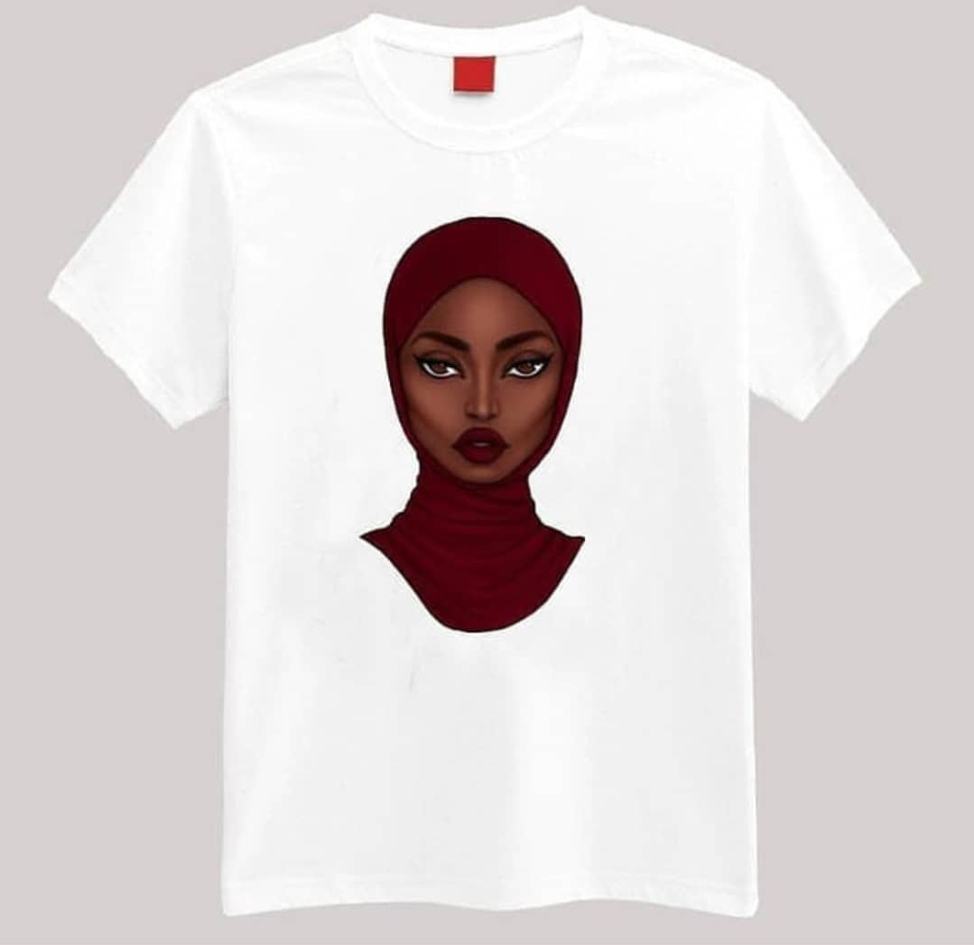
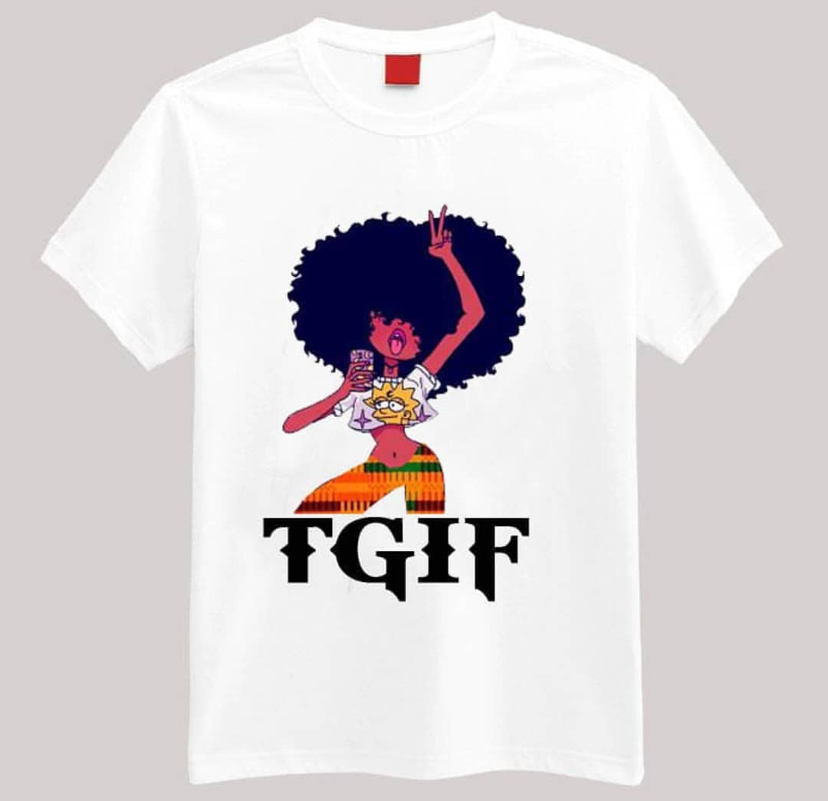

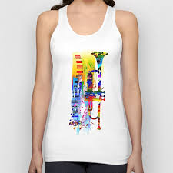
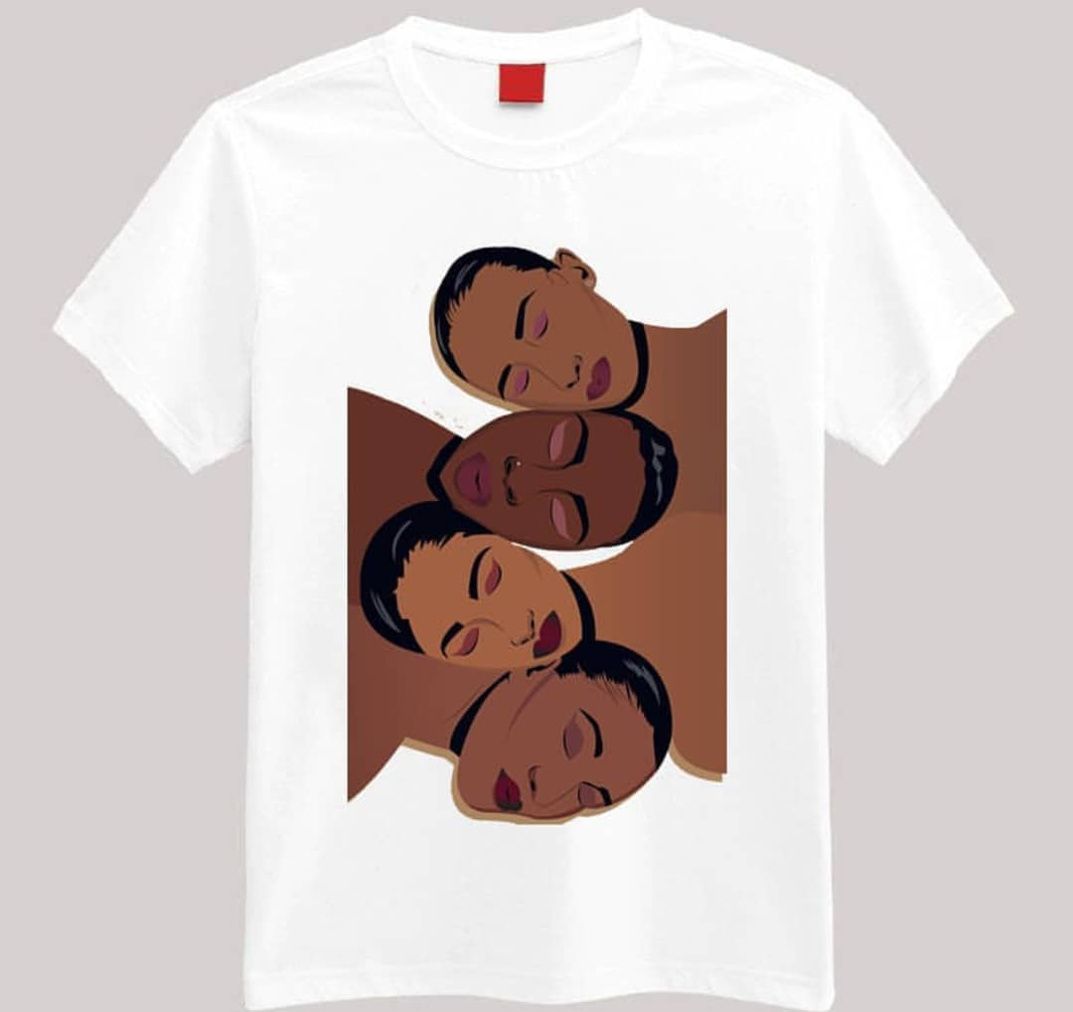
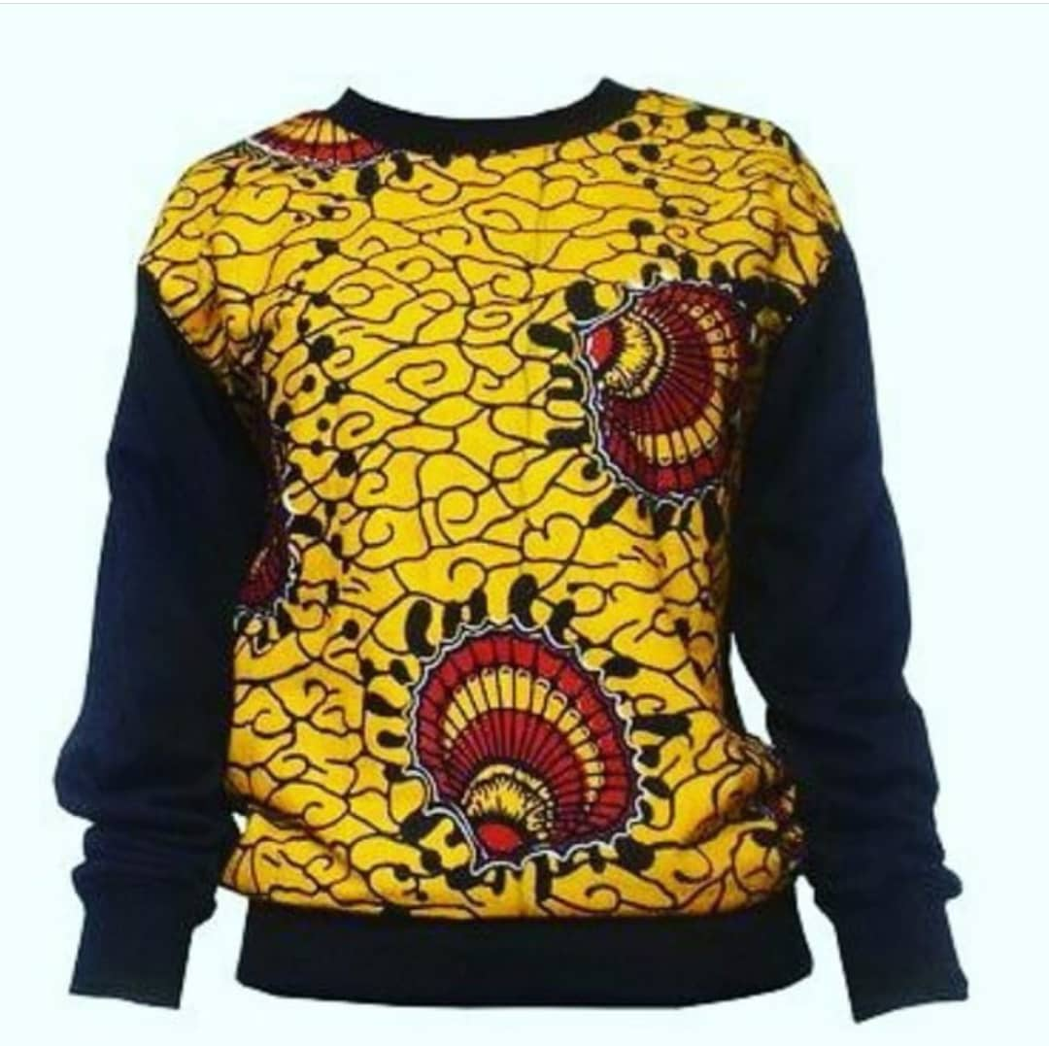
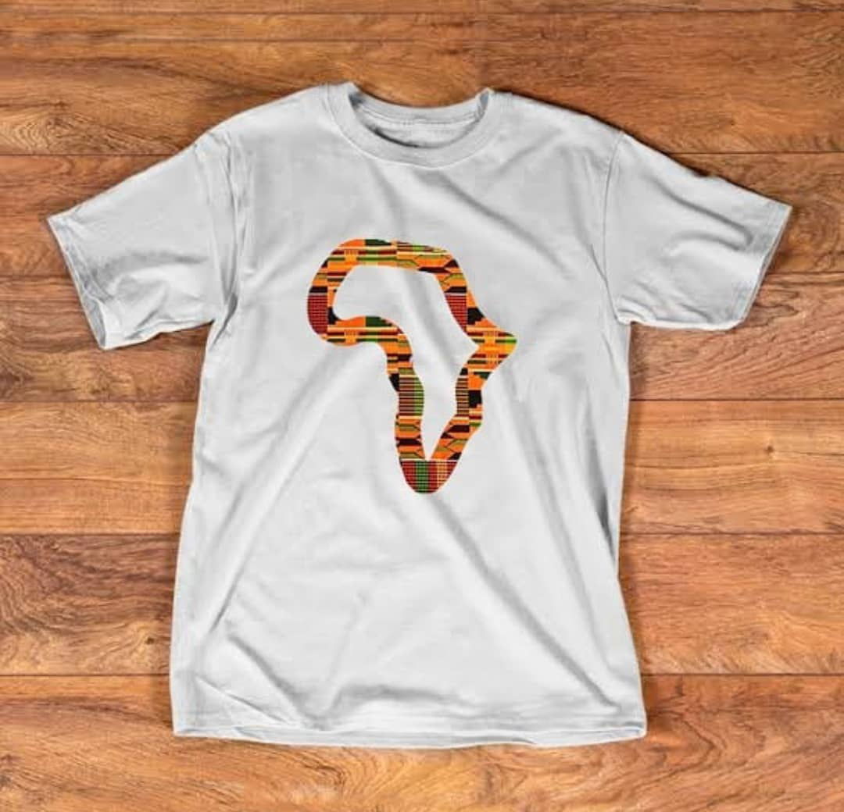
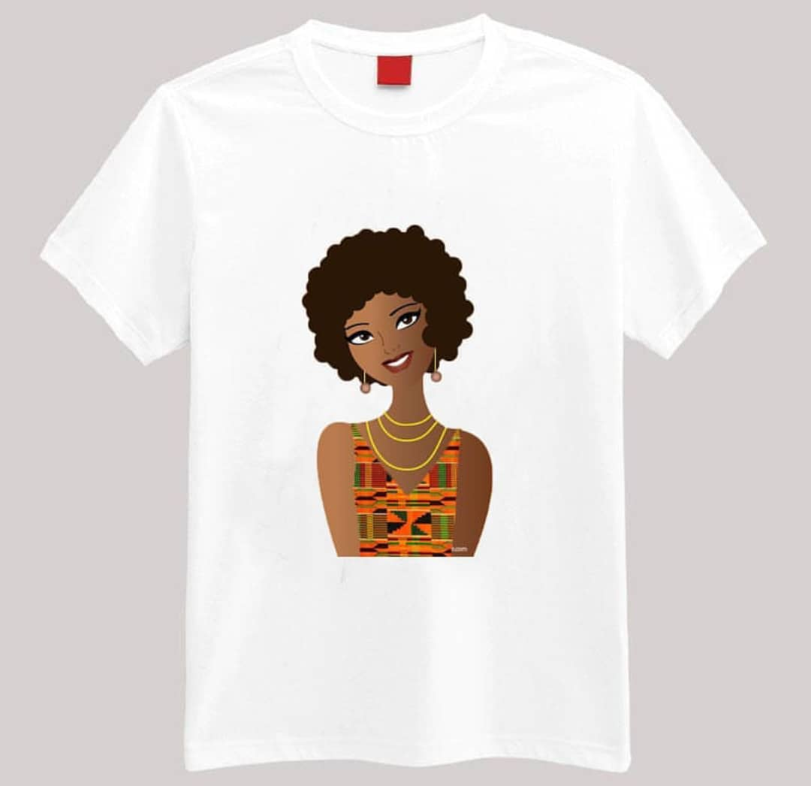
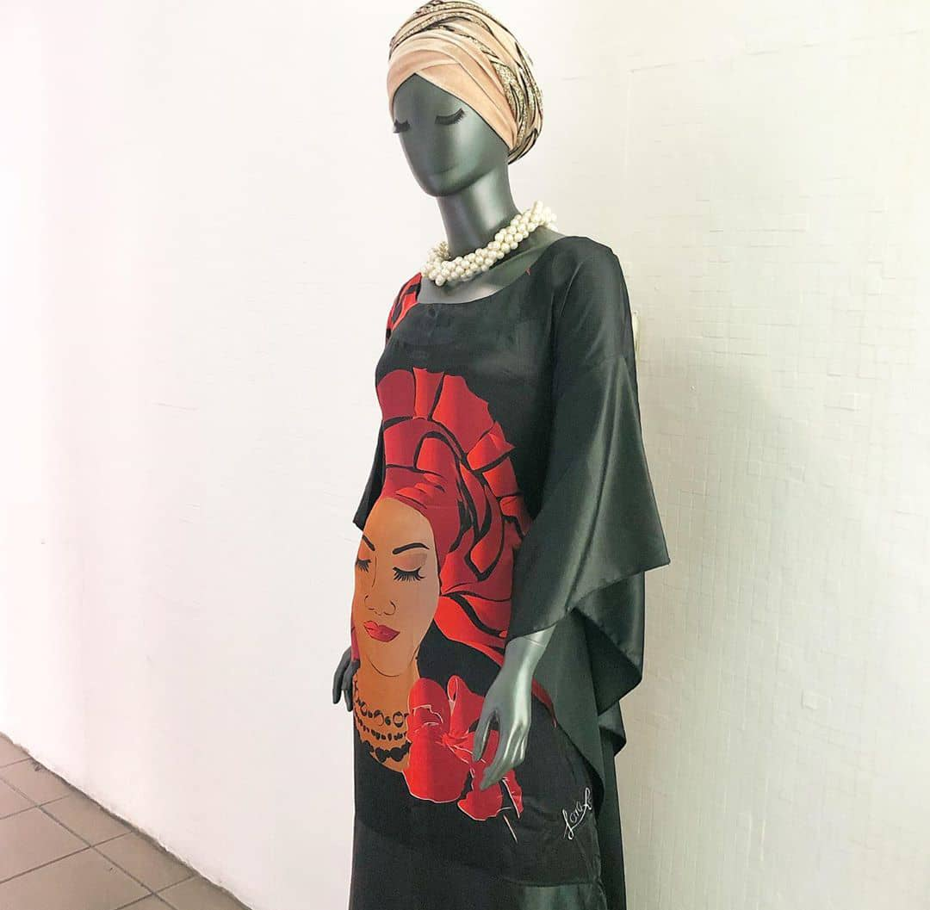
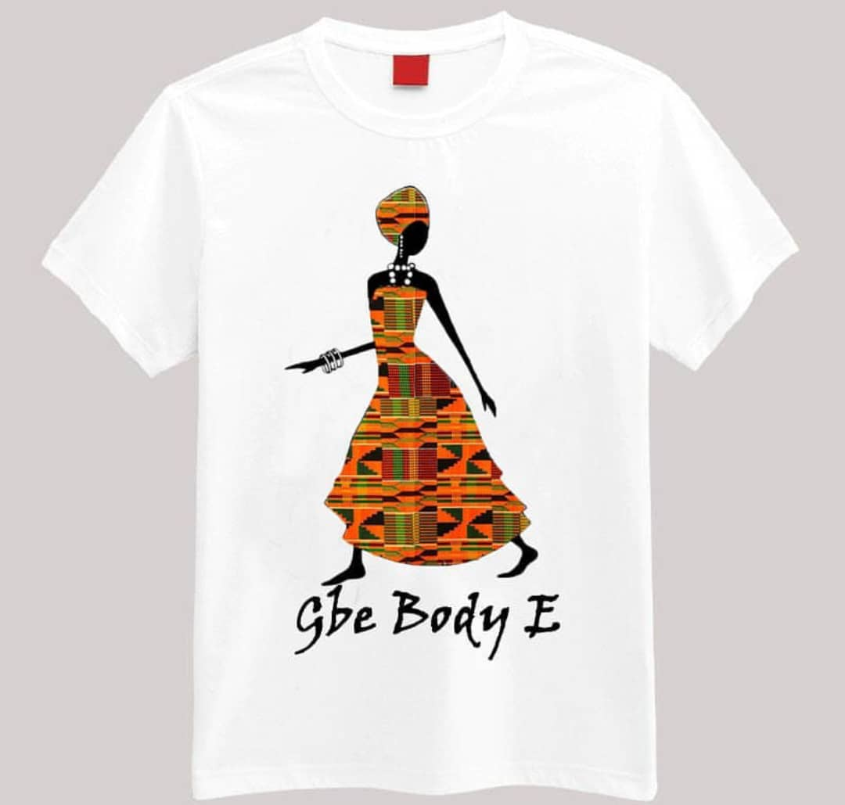
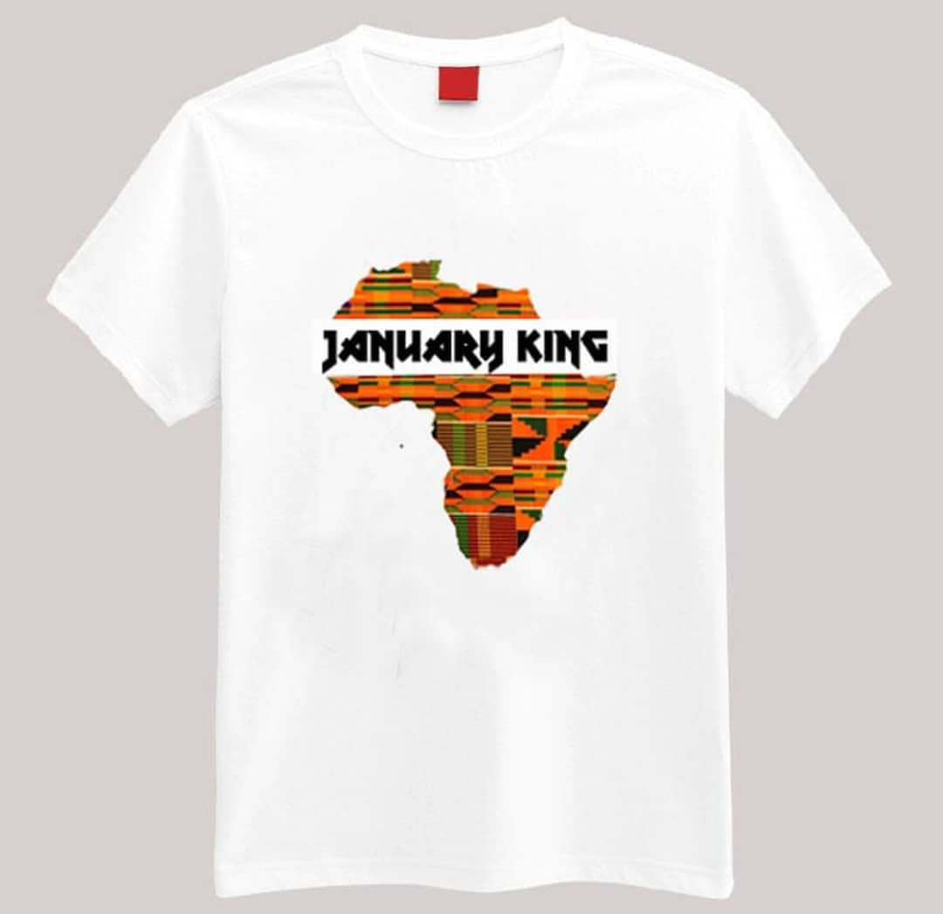

Slide 7
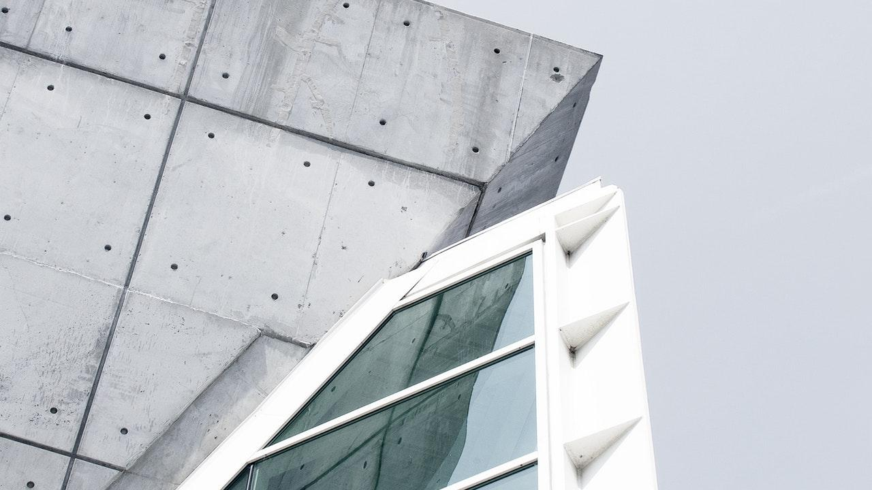
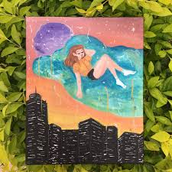
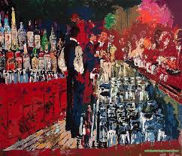
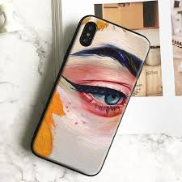
Big picture SDG 8
DECENT WORK AND ECONOMIC GROWTH

Slide 8
Customer Segment
2 customers
a. Users: Art lovers
b. Artists and sellers of wearable art

Slide 9
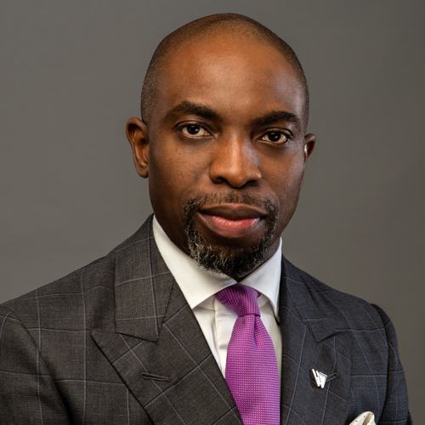
Customer Segment
Segment a
Art lovers (user)…. Persona profile
Chike is a middle aged art lover who earns NGN 400,000 monthly. As much as he loves art, he can only spare 20,000 naira monthly to buy art as he also has to provide for his own family.
Artycool is his solution!

Slide 10
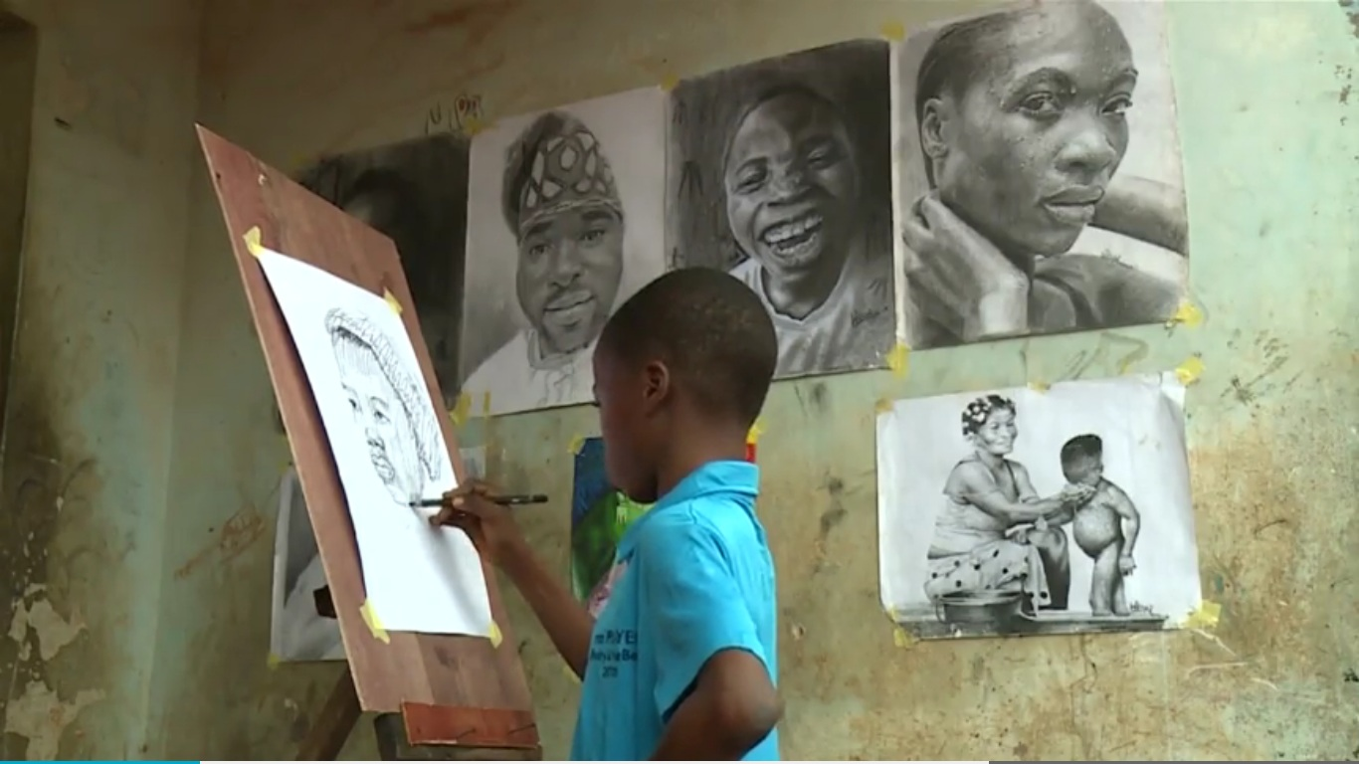
Customer Segment
Segment b
Artists (buyer)…. Persona profile
Tomiwa is a 15 year old artist who cannot afford to go to Univeristy after secondary school because of his poor background. He has been saving money for school from selling his art work, but sales are very slow and his hope is getting dim.
Artycool is his solution!

Slide 11
CHANNELS (AIDA)

Slide 12
AIDAOR
ATTENTION
INTEREST
DESIRE
ACTION
ONBOARDING
RETENTION

Slide 13
AI-attention and interest
ATTENTION
We intend to used social media handles that give us access to a wide reach of customers such as Instagram and facebook.
We also intend to print flyers and distribute to local artists.
INTEREST
We would create catch content that focuses on :
A solid business platform for our buyers.
Variety and convenience for our users

Slide 14
DA-Desire and Action
DESIRE
For the buyer, we are creating the desire to step out of obscurity and step into the limelight.
For the user, they get a very wide variety of iconic, yet affordable artwork.
ACTION
The buyers would sign up for free through our user ID page and upload their items on our page after passing through proper quality control.
Users would simply shop and pay through the ecommerce platform

Slide 15
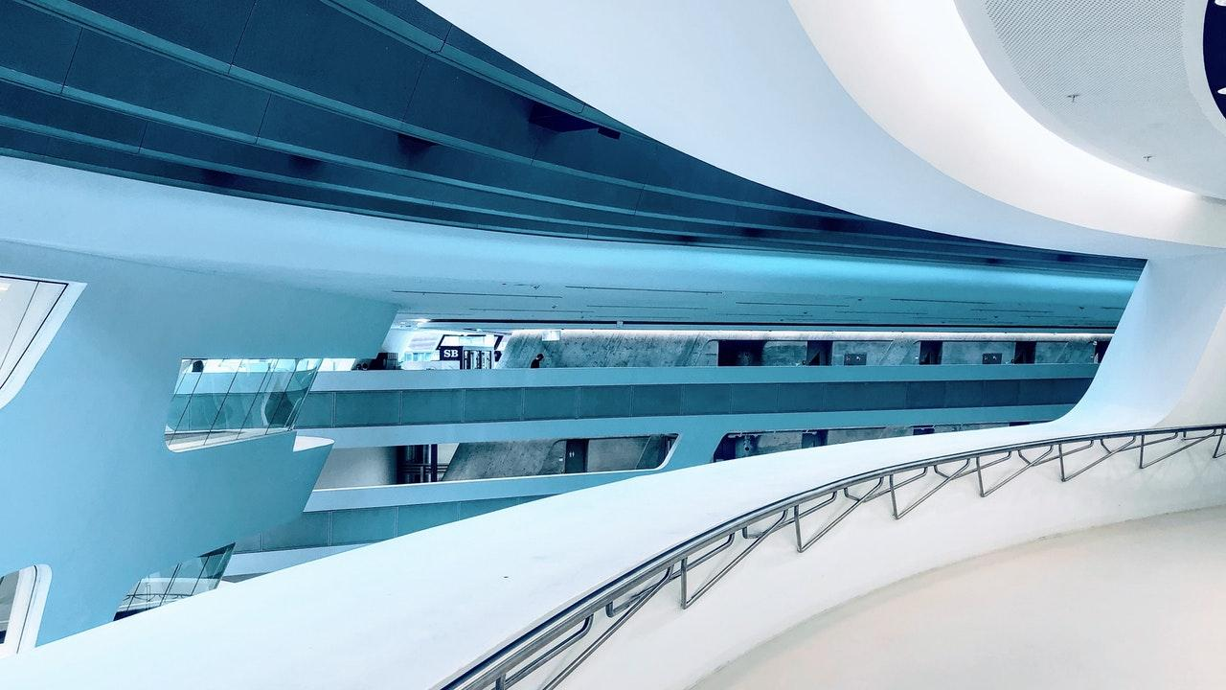

Channels
To sell via the web platform by partnering with art makers
Product can be delivered through pick up at a meeting point or doorstep.
Promote product through referrals
Promote products through Google ad words.
Promote product through having an art showcase.

Slide 16

Customer Relationship
Post sales quality control calls made 3 days after each sale
5 day return window policy
Link to insurance for bid merchandise only

Slide 17
Revenue Streams
Commission from sale of Artwork
Commission from Sale of wearable Art
Commission from bid
…all at 10 percent

Slide 18
KEY ACTIVITIES

Slide 19
OUR KEY ACTIVITIES INCLUDE:
Sourcing for and attracting great talent as well as great customers to our platform…ADVERTISEMENT
Ensuring great user experience on our website by buyers and sellers….reviews, upgrades, etc.. WEBSITE ADMINISTRATION and CUSTOMER SERVICE

Slide 20
KEY RESOURCES

Slide 21
KEY RESOURCES
TALENT TO HANDLE OUR KEY ACTIVITIES AS PREVIOUSLY LISTED
CASH:OPERATING EXPENSES, SALARIES, PUBLICITY.

Slide 22
KEY PARTNERS

Slide 23

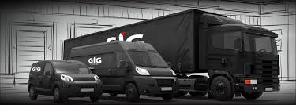
GIG logistics
We do not immediately intend to have our own logistics company in the short run, although this is in the long run pipeline gauge.
We would therefor be working with a logistics to ensure prompt delivery.

Slide 24
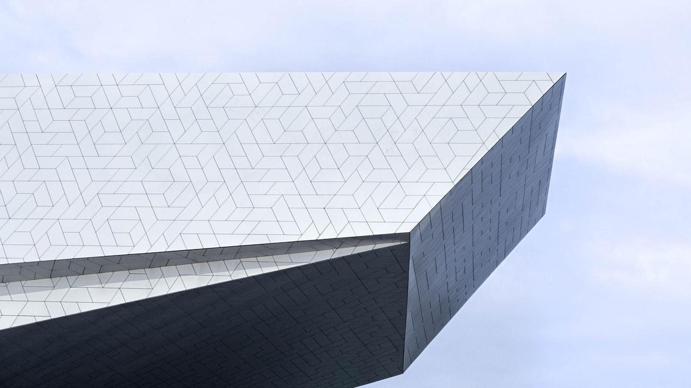
OVERVIEW OF FINANCIAL PLAN
Startup costs:
NGN 600,000
Projected Annual Revenue
Gross Profit
NGN 1,000,000 monthly
NGN 400,000
Margin: 66.67%.

Slide 25

START UP COST BREAKDOWN
Item | Value
Website hosting | NGN 55,000
Publicity and branding | NGN 105,000
Payment for staff | NGN 240,000
Running Expenses | NGN 200,000
Total | NGN 600,000

Slide 26
Projected revenue BREAKDOWN
Item | Value
Sales of art(Average price of 4000 x 200 transactions) | NGN 800,000
Bidding platform (Average price of 100,000 x 2 transaction) | NGN 200,000
Total | NGN 1,000,000
Less Costs | (NGN 600,000)
MONTHLY GROSS PROFIT | NGN 400,000

Slide 27
FINANCIAL BREAKDOWN
 | Year 1 | Year 2 | Year 3
Sales | NGN 12,000,000 | NGN 15,000,000 | NGN 20,000,000
Costs | NGN 7,200,000 | NGN 8,000,000 (scale up salaries) | NGN 12,000,000 (office space)
Gross Profit | NGN 4,800,000 | NGN 7,000,000 | NGN 8,000,000

Slide 28
Value proposition
Affordable prices for all income levels
Very wide range of choices
Convenience and excellent customer service
Sustainable sales for artists
Exposure for artists
Affordable business platform

Slide 29

THANKS!
Any questions?

Slide 30
CREDITS
Special thanks to all the people who made and released these awesome resources for free:
Presentation template by SlidesCarnival
Photographs by Unsplash

